Slide 1


Analyze Movie Big Data Set for Crowdfunding
Presented By DATA WARRIORS:
Aishwarya Iyengar
Smita Kulkarni
Swathi Badicole
GitHub Link: https://github.com/Smitashri/DataWarriors

Slide 2


Problem Statement & Goal
Crowdfunding in simple words is asking a crowd for your movie funding. But, in order to fund any movie, a good data is critical
There is no good project today supporting analysis on movie dataset from crowdfunding perspective
Major objective is to help with Crowdfunding decisions
Understand and learn handling big data
Understand and learn ETL process
Understand and learn data warehouse designing, usage etc.
Understand how Business Analytics can be performed on data warehouse

Slide 3


Data Source & Audience
Why this dataset?
Our Audience?
How will this help?
This real-time dataset from IMDB and Movie Industry have the data of movies starting from 1874-2021 across various countries
Movie dataset from IMDB was supporting our analysis from crowdfunding perspective
Investors/ Funders to movie
Movie makers interested in raising a crowdfunding campaign
General Public interested in movie trends
This analysis can help general public/movie makers interested in crowdfunding to understand
What genre movies are popular
What movies have highest amount of ratings
This analysis can be a pre-requisite for building a recommendation model to any investor.

Slide 4
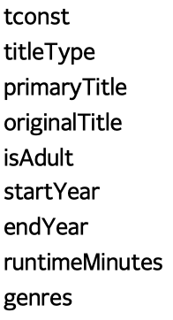
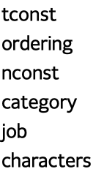
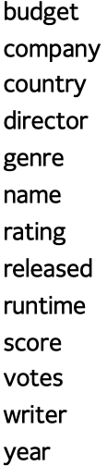
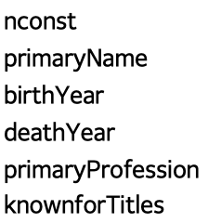
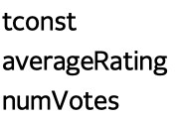
Dataset Details
IMDB Dataset
Movie Industry Dataset
title.basics (1 GB)
title.principals (2.5 GB)
movie(2 MB)
name.basics (800 MB)
title.ratings (50 MB)

Slide 5
Technology Overview
Data Source
IMDB and Movie Industry: As part of our research, we found a very good data source that we could use for our analysis
Data Storage
Amazon S3: We found this option to be economical for storing Big Data Set
Amazon Glue: This option presented itself to be economical and was also very well known
Data Analysis
Python We wanted to make use of our Python experience for this analysis
ETL
Data Warehouse
Amazon Redshift: As part of our research, we found this simpler and compatible with Glue
Analytics
Power BI: We wanted to make use of prior experience for data analytics
PySpark: This option presented itself to be readily available with Glue ETL jobs
Documentation
Microsoft Word and PowerPoint We wanted to use readily available Microsoft products
ETL Script

Slide 6



Data Preprocessing
Deep Dive into data using Python
title.basics
title.ratings
title.principals
name.basics
movie
Movie_cleaned_data
Data Files Uploaded to Amazon S3
Data Preprocessing and Cleaning using Python

Slide 7



Steps Followed Overview
Movie Big Dataset uploaded to AWS S3 Bucket
Step1
Step2
ETL Performed using Amazon Glue Jobs and Scripts
Redshift Data-warehouse populated with data using AWS Glue Jobs
Step3
Step4
Deep Dive into data warehouse data using BI Tool
Step5
Insightful Visualization achieved

Slide 8




End to End Data Flow
Four Crawlers created to read data from S3
ETL jobs created to populate the Data in Redshift
BI Tool Power BI used to analyze data

Slide 9
Data-Warehouse Design : Star Schema
dimension_movie
dimension_castcrew
d_movie_id
d_budget
d_title
d_rating
d_votes
d_genre
d_original_title
d_runtime
d_gross
d_country
d_company
d_isadult
d_releaseyear
d_name_id
d_name
d_yearofbirth
d_deathyear
d_primaryprofession
d_otherprofession
d_knownformovie
fact_movie
f_name_id FK
f_movie_id FK
f_crewcast_category

Slide 10
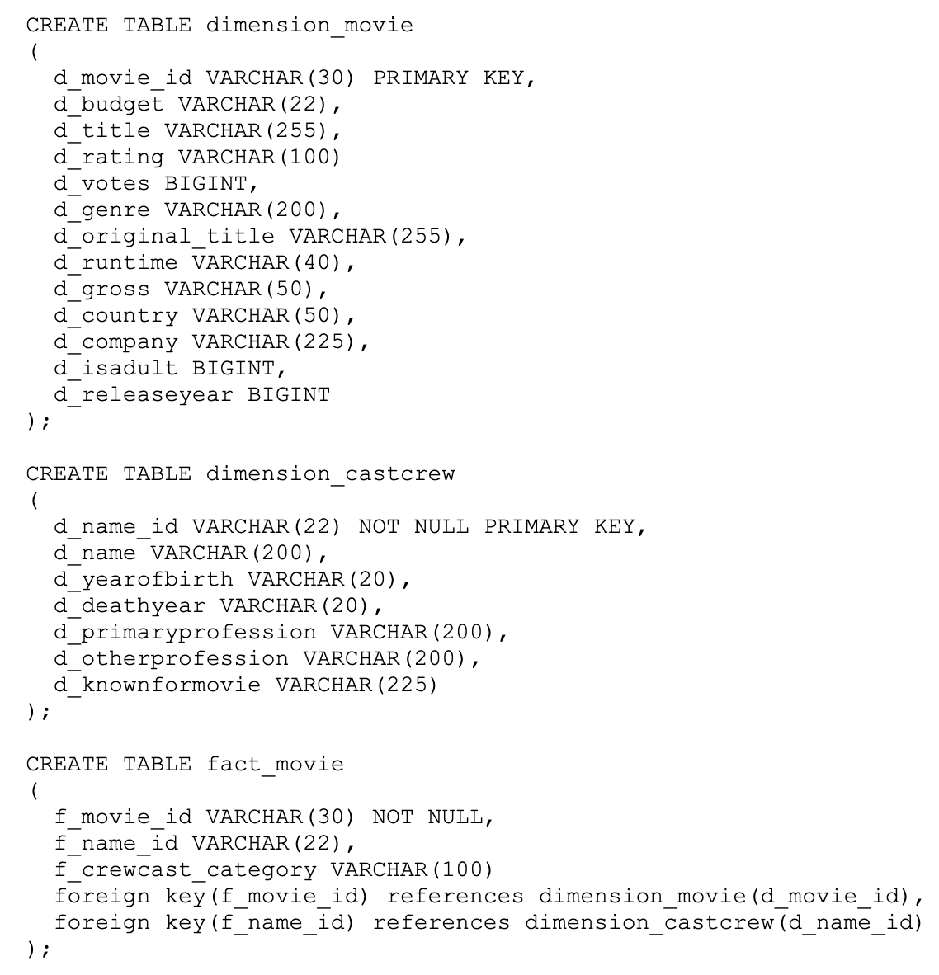
Script used to create tables on Redshift

Slide 11
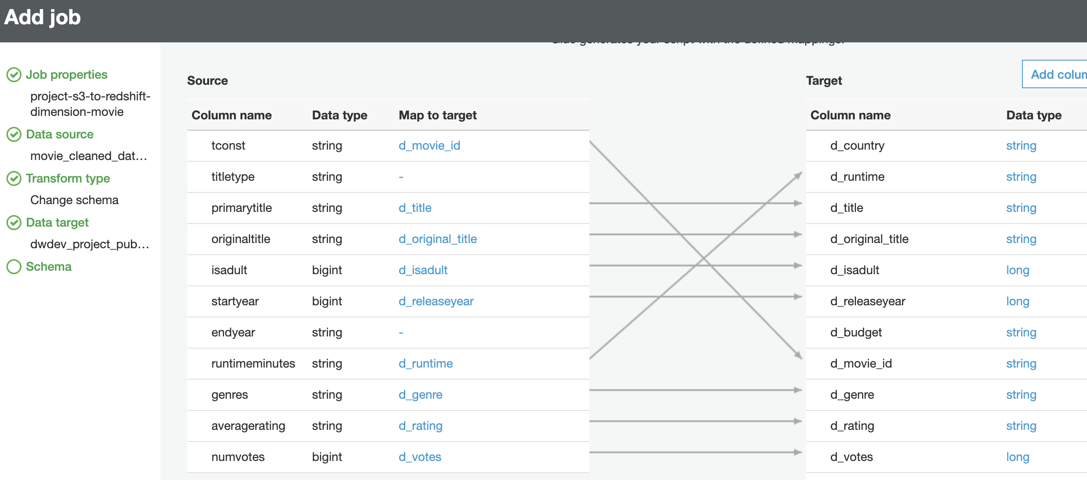
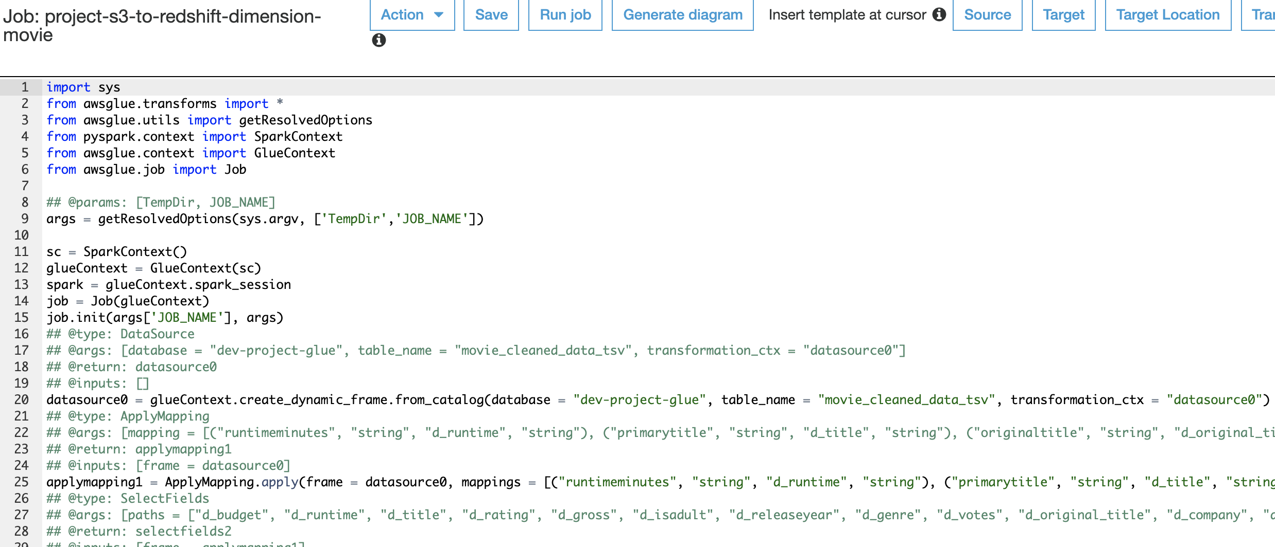
ETL Example

Slide 12

DEMO

Slide 13


Crawlers and Job Details for ETL
Glue Crawler for S3 name.tsv | project-glue-crawler1-s3
Glue Crawler for S3 movie_cleaned_data.tsv | project-glue-crawler2-s3-movie-cleaned-data
Glue Crawler for S3 titleprincipal.tsv | project-glue-crawler3-s3
Glue Crawler for movie_industry_cleaned.tsv | project-glue-crawler4
Glue Crawler for Redshift | project-glue-crawler2-redshift
Glue Job Name for fact_movie | project-s3-to-redshift-fact-movie
Glue Job Name for dimension_movie | project-s3-to-redshift-dimension-movie
Glue Job Name for dimension_castcrew | project-s3-to-redshift-dimension-castcrew
Glue Job Name for dimension_movie – Alternative Source from Movie Industry | project-s3-to-redshift-movie-industry-dimension-movie
Glue Job Name for dimension_castcrew – Alternative Source from Movie Industry | project-s3-to-redshift-movie-industry-dimension-castcrew-directors
Glue Job Name for fact_movie – Alternative Source from Movie Industry | project-s3-to-redshift-movie-industry-fact-movie

Slide 14
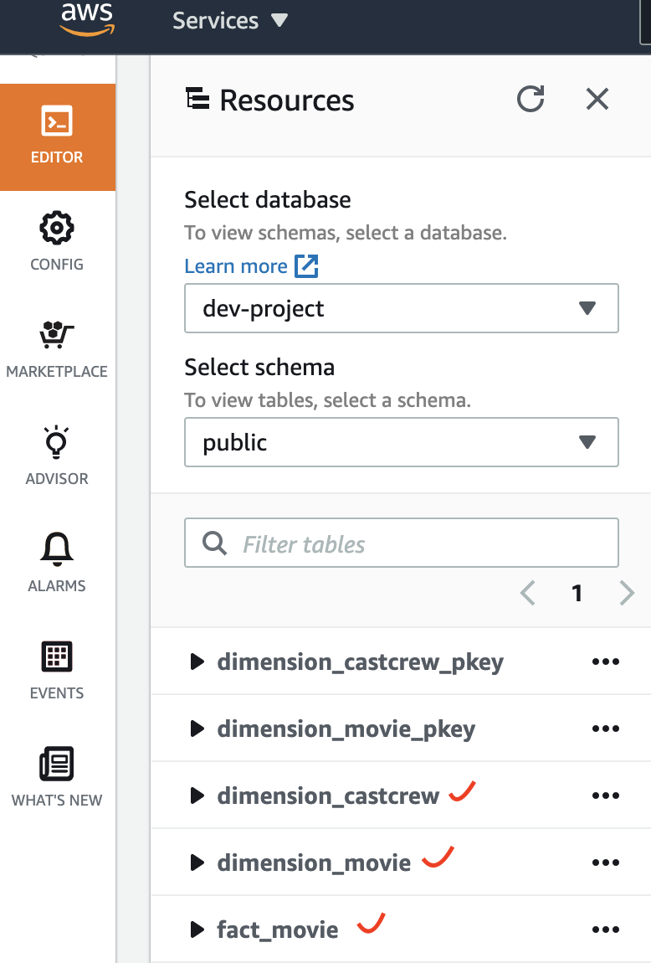
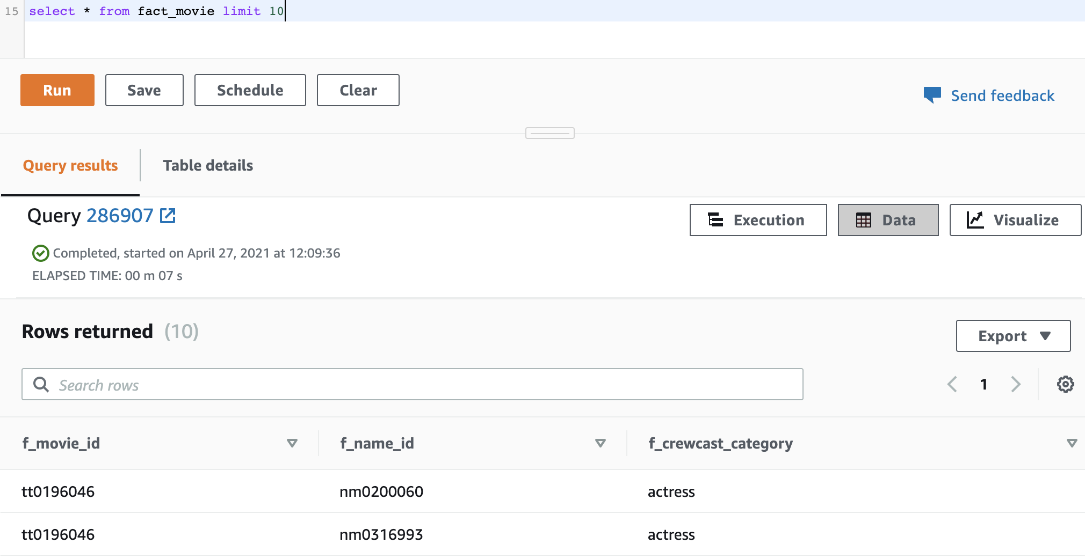
RedShift Details : Tables created using Script & Data populated using ETL Jobs

Slide 15
Analytics & Results – DashBoard#1

Slide 16
Analytics & Results - DashBoard#2

Slide 17

Data Security and Future Work
User Management: AWS Accounts, Groups, and Roles.
Amazon Virtual Private Cloud (VPC) provides a private area that's isolated from other users. It also has layer 3 isolation from the internet.
Future Scope:
To protect our data as it moves, making sure it's encrypted using SSL/TLS or IPSec ESP.
Expand the data set to Netflix, Amazon prime, Rotten Tomatoes and many well known famous movie Data sources

Slide 18

Testing
1. Validate if fact_movie table on Redshift is populated correctly
2. Validate if dimension_movie table on Redshift is populated correctly
3. Validate if dimension_castcrew table on Redshift is populated correctly
4. Validate if Glue crawlers can read the data from S3 Files correctly
5. Validate if the ETL process is executed correctly across each step

Slide 19
Milestone
16
23
16
13
11
February
February
March
April
May
Project Proposal
Upload a sample dataset to S3
Compute and Analyze
Analyze Big Dataset
Testing
Project Report
Documentation
Final Project Presentation

Slide 20


Conclusion
Interested in funding a movie? You are at the right place. Our project will felicitate all data you may need for the decision.
We have the data of movies starting from 1874-2021 across various countries

Slide 21
Resources
Here are the references for the literature survey
https://www.researchgate.net/publication/264555968_Big_Data_Analytics_A_Literature_Review_Paper?_sg=QdVKPLFc0L3Slw2bLshmh7KpuzjnnA7q7NuqHvzW4P3JkxiGs020OZZvvQwEVAUI8gNb56s5gyPxnIk (PDF) A comparative study of various ETL process and their testing techniques in data warehouse (ResearchGate. Net)
https://scholar.smu.edu/cgi/viewcontent.cgi?article=1080&context=datasciencereview
https://www.mdpi.com/2199-8531/6/3/80
Image-based recommendations on styles and substitutes J. McAuley, C. Targett, J. Shi, A. van den Hengel SIGIR, 2015
Inferring networks of substitutable and complementary products J. McAuley, R. Pandey, J. Leskovec Knowledge Discovery and Data Mining, 2015

Slide 22
Thank You!

